Slide 1
WHY VMWARE CLOUD ?
JAMES KILBY

Slide 2
Intro / Agenda
VMware Introduction
VMware Clouds Overview
AWS Introduction
VMware Cloud on AWS
Business Challenges
Technical Overview

Slide 3


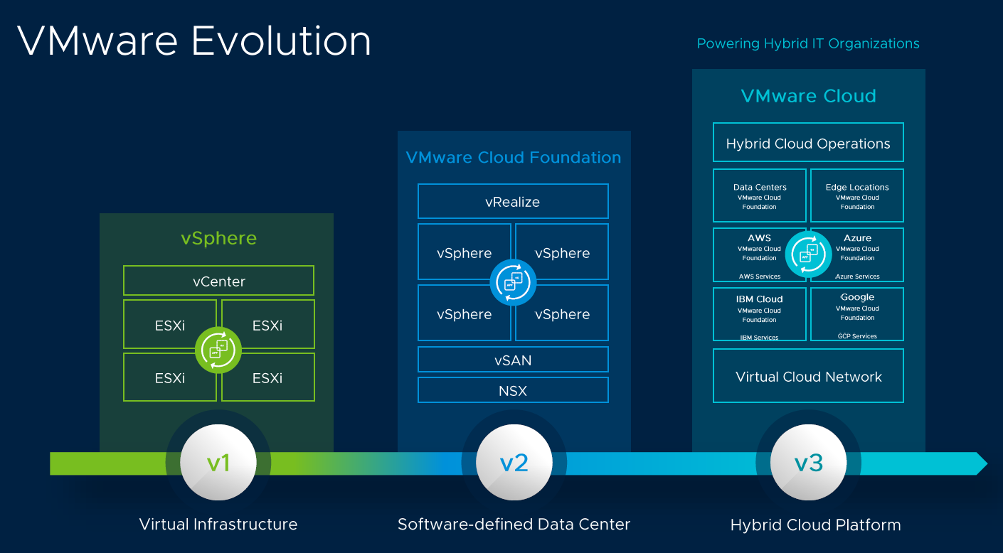



VMware Introduction
World Leader in Virtualization technology
Notes:
Founded in 1998

Slide 4
VMware Clouds Overview
VMware Cloud on AWS
Azure VMware Solution
Google Cloud VMware Engine
IBM Cloud for VMware Solutions
Oracle Cloud for VMware Solution
VMC on Outposts
VMware Cloud on Dell EMC

Slide 5
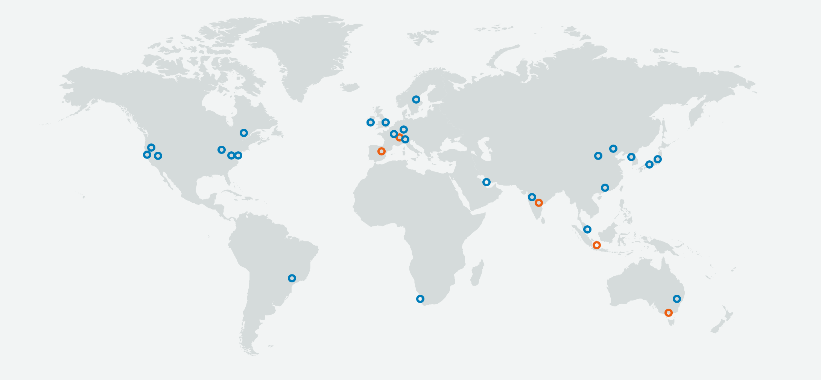
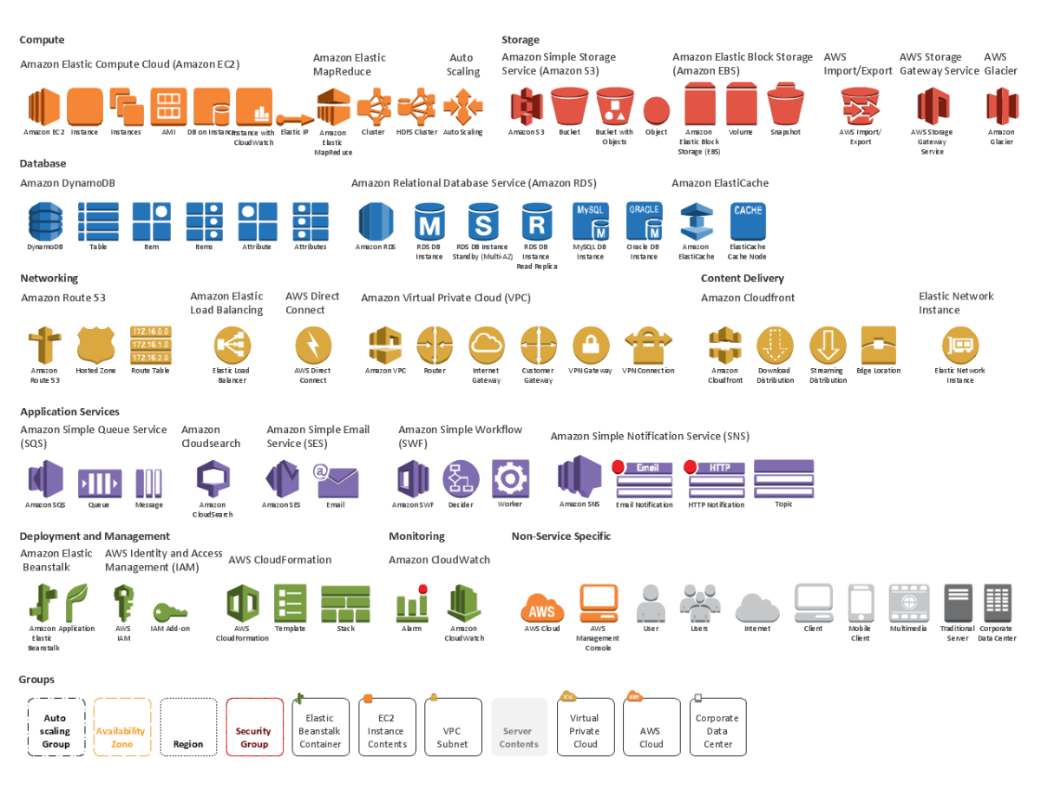
AWS Introduction
25 Global Locations
175 AWS Services
Notes:
On demand infrastructure for web computate services
and Introduced in 2006. AWS is the largest public cloud offering
25 Global regions with 175 AWS Services
Compute – Network Firewall, Storage, Database DNS
IOT Virtual desktop, Directory services etc

Slide 6






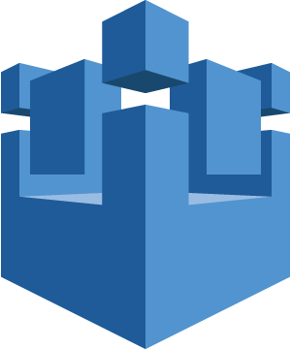


VMware Cloud on AWS Overview
vRealize Suite, vSphere Integrated Containers, ISV Ecosystem
Operational Management
VMware Cloud™ on AWS Powered by VMware Cloud Foundation
Native AWS Services
…
…
vCenter
vCenter
Amazon EC2
Amazon S3
Amazon RDS
vSphere
vSAN
NSX
…
…
ESXi on Dedicated Hardware
Support for VMs and Containers
vSAN on Flash and EBS Storage
Replication and DR Orchestration
NSX Spanning on-premises and Cloud
Advanced Networking & Security Services
AWS IoT
AWS Direct Connect
AWS IAM
Customer Data Center
AWS Global Infrastructure
AWS Global Infrastructure
AWS Global Infrastructure
Notes:
Service run by Vmware with AWS
AWS run all physical resources
Vmware manage hypervisor and management fuctions
140 Partners validated

Slide 7
Business Challenges
Complexity
Operational Consistency
Sizing + Scale
Migration to Native Cloud is Complex
Operational skills in multiplatform’s
Maintenance + Upgrades
Complex networking
Notes:
VMC comes with HCX for easy migrations ( or Data center extensions)
No expensive recruiting or retraining

Slide 8
Removes Complexity
Automated SDDC deployment
Single or Multi AZ SDDC options
Deployment to VMware best practice vSphere, vSAN & NSX
Notes:
Dataventre deployment in 3 Hrs vs 3 Months
Automatic Partition placement\
Multi AZ Single tick option

Slide 9
Operational Consistency
Support provided directly by VMware
All Stack Maintenance and upgrades managed by VMware
Same toolset can be used for :
Provisioning
Backups
Monitoring
Notes:
Supported by Vmware
Same VC endpoiunt. Tools that work on prem for provisioning
Software defined tag for networking or backups or operations

Slide 10
Sizing + Scale
Host Count to match the compute workload.
Quickly and easy scale up and scale down
Rapid scale out feature
Elastic DRS
Optimize for cost on an hourly basis
On demand/reserved purchase options
Notes:
Start Small. 1 or 2 host
Undersizing an onprem environment Is bad. Leading to performance issues
Oversizing is a waste of money
EDRS cluster level
10 SDDC’s per Org
20 Clusters per SDDC
16 Hosts per Cluster
2 host types i3 and i3en

Slide 11
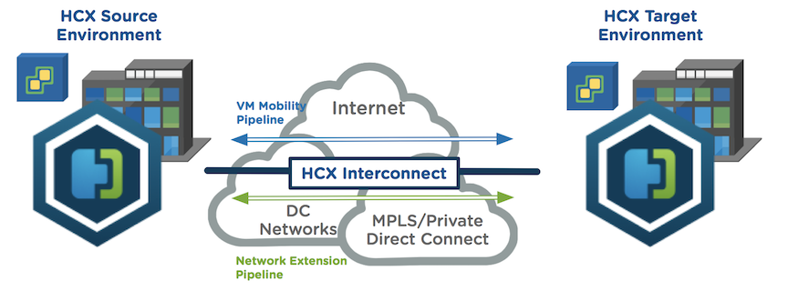
Migration with HCX
USE Cases:
Data Centre Extension
Data Centre Replacement
Disaster Recovery
Disaster Avoidance
Notes:
Free for VMC customers
VPN or Direct Connect migration options.
Direct Connect can do live migrations

Slide 12
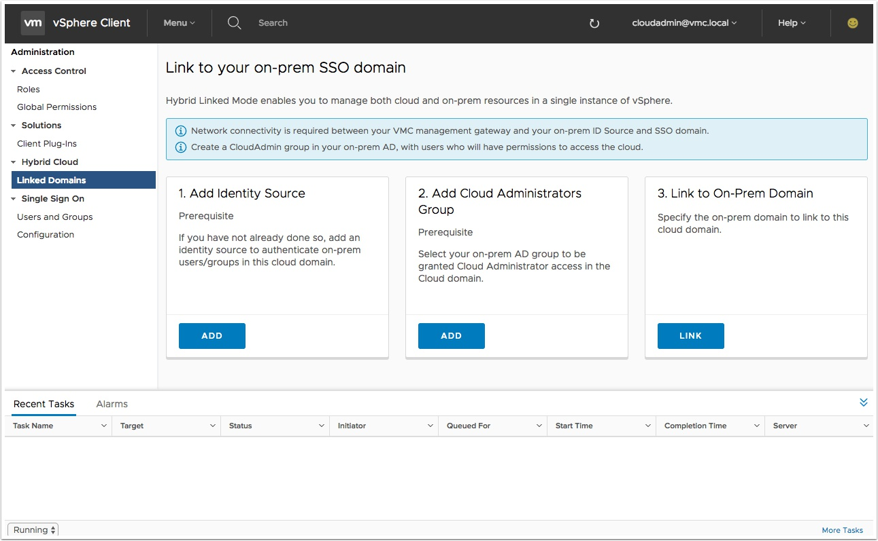
Operational Skills
Hybrid Linked mode offers the same experience
Deployed in 3 easy steps
Notes:
Hybrid Linked Mode
VM deployed and linked to local VC

Slide 13
Maintenance + Upgrades +Faults
Hardware faults – Automatically detected and remediated.
Upgrades are included in the service.
Notes:
Pay for a service of hosts.
EVEN odd SDDC version ODD SDDC by request only

Slide 14
Maintenance + Upgrades +Faults
1.
HOST FAILS, OR PROBLEM IDENTIFIED
vSAN Cluster
2.
NEW HOST ADDED TO CLUSTER.
DATA FROM PROBLEM HOST REBUILT, AND/OR MIGRATED
vSAN Cluster
3.
PREVIOUS HOST EVACUATED FROM CLUSTER, FULLY REPLACED BY NEW HOST
vSAN Cluster

Slide 15
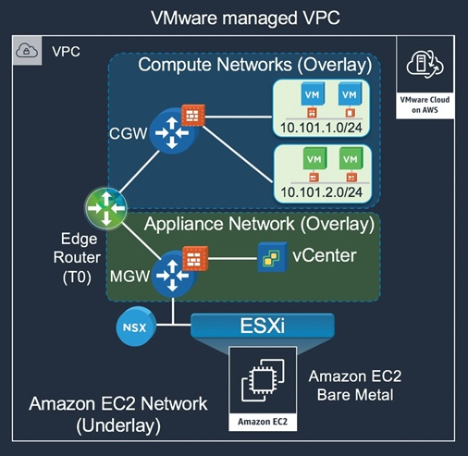
VMC Component Overview
Notes:
EC2 Underlay bare metal esxi. NSX t
2 gateways mGW for VC etc
CGW for workload plus DFW

Slide 16
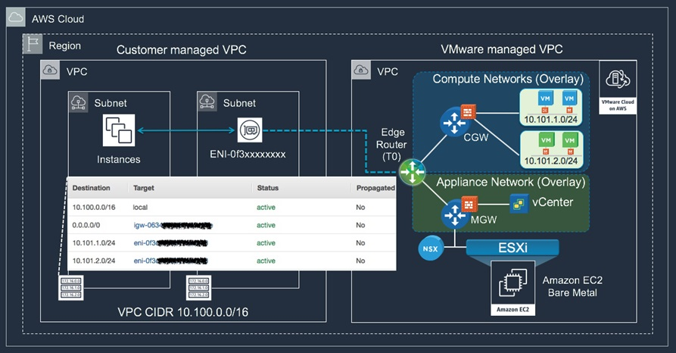
Customer + VMware VPC
Notes:
ENI – 25GBps low latency 0 cost link between native aws and VMC

Slide 17
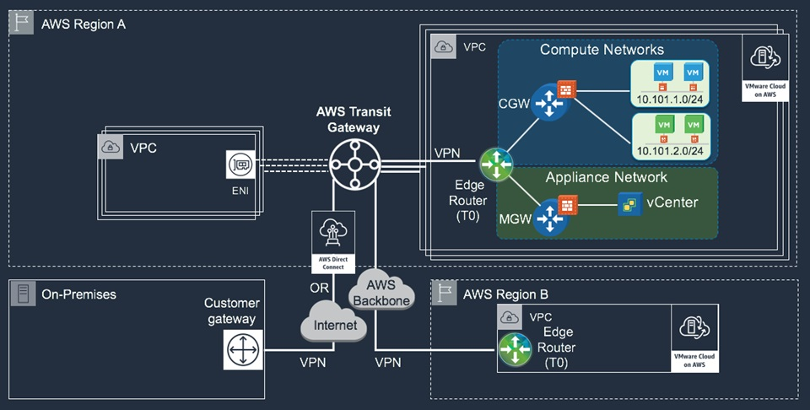

Slide 18
Bonus Features
Built in Developer Centre
Built in Chat
HCX
VMware Site Recovery
Hybrid Linked Mode
Tanzu
SDWAN
NSX Advanced Load Balancer
Integration with other VMware Cloud Services:
vRealize Log Insight Cloud
vRealize Operations Cloud
vRealize Network Insight Cloud
VMware Cloud Assembly
VMware Code Stream
Vmware Cloud Disaster Recovery

